Slide 1
Summer Internship 2024

Slide 2




Introduction
University of Maryland – College Park
Major: Computer Science
Development Intern

Slide 3
Overview
01
Developer Portal - An Outsider's Perspective
06
Internship Outcomes
02
Problem Statements
07
Resources
03
Tutorials
04
Meet InDevA
05
InDevA's Story

Slide 4
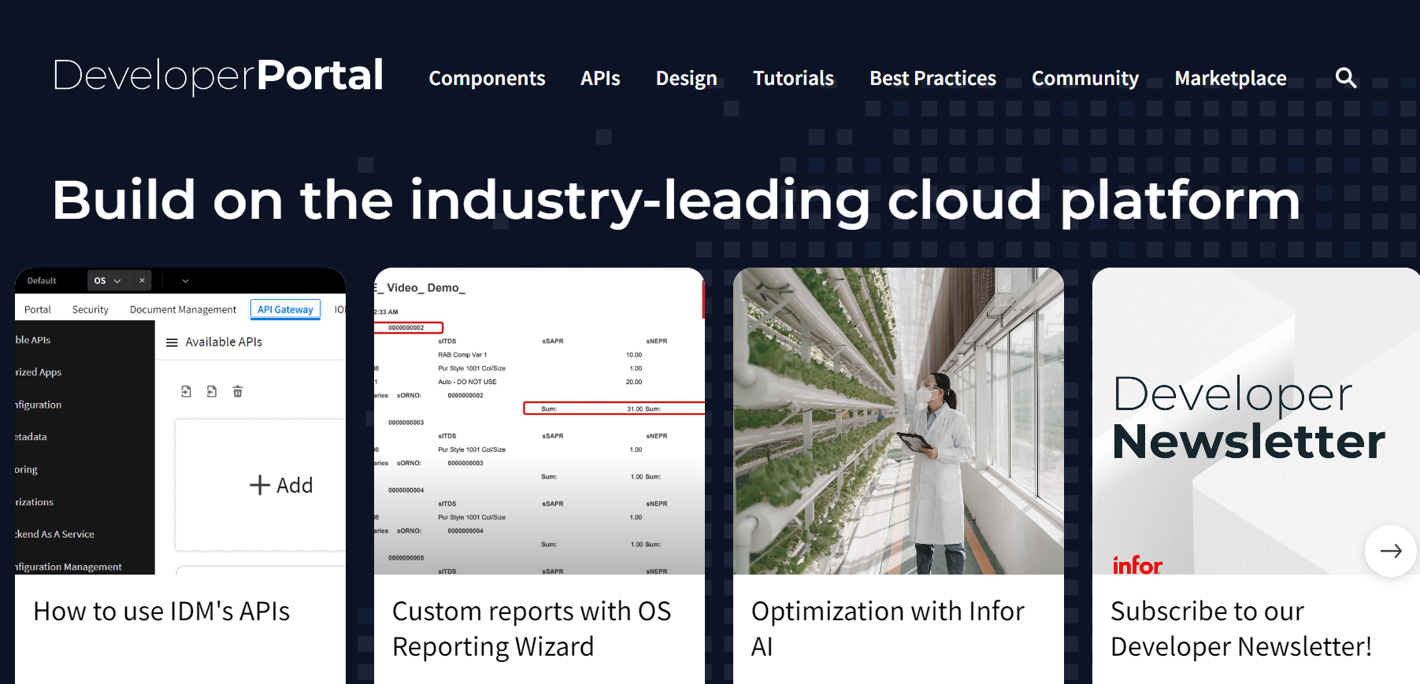
An Outsider's Perspective of the Developer Portal
Task: Explore the Developer Portal from an outsider's perspective and provide first impressions.
Observations:
Inconsistency with content formatting and tutorials
Outdated information
Missing written tutorials for some videos
Notes:
My first assignment was to explore the Developer Portal and write about my first impressions as an outsider without prior knowledge of InforOS. Some things that I noticed were:
Inconsistency with content formatting and tutorials -> tutorials were more detailed than others, tutorials had each step written as a paragraph and other tutorials had short, bulleted lists
Outdated information -> Coleman AI being used even though it is referred to as just AI, many applications had new features added and they were not reflected in older tutorials
Missing written tutorials -> Most of the tutorials in the tutorials section had corresponding YouTube videos, but there were some YouTube videos that lacked a written portion

Slide 5


Problem Statements
To address those observations, solutions were proposed through two projects.
Project 1: Tutorials
This project addresses the following:
Gaps in content
Misalignment between the Developer Portal and YouTube content
Project 2: AI Model
This project addresses the following:
Inconsistency in content across multiple contributors
Notes:
As a way to address those observations, I worked on 2 projects.
First project: Filling in those gaps in content by following the YouTube videos and writing tutorials to help connect Developer Portal and YouTube
Second project: Building an AI model that can help with the inconsistency in content

Slide 6
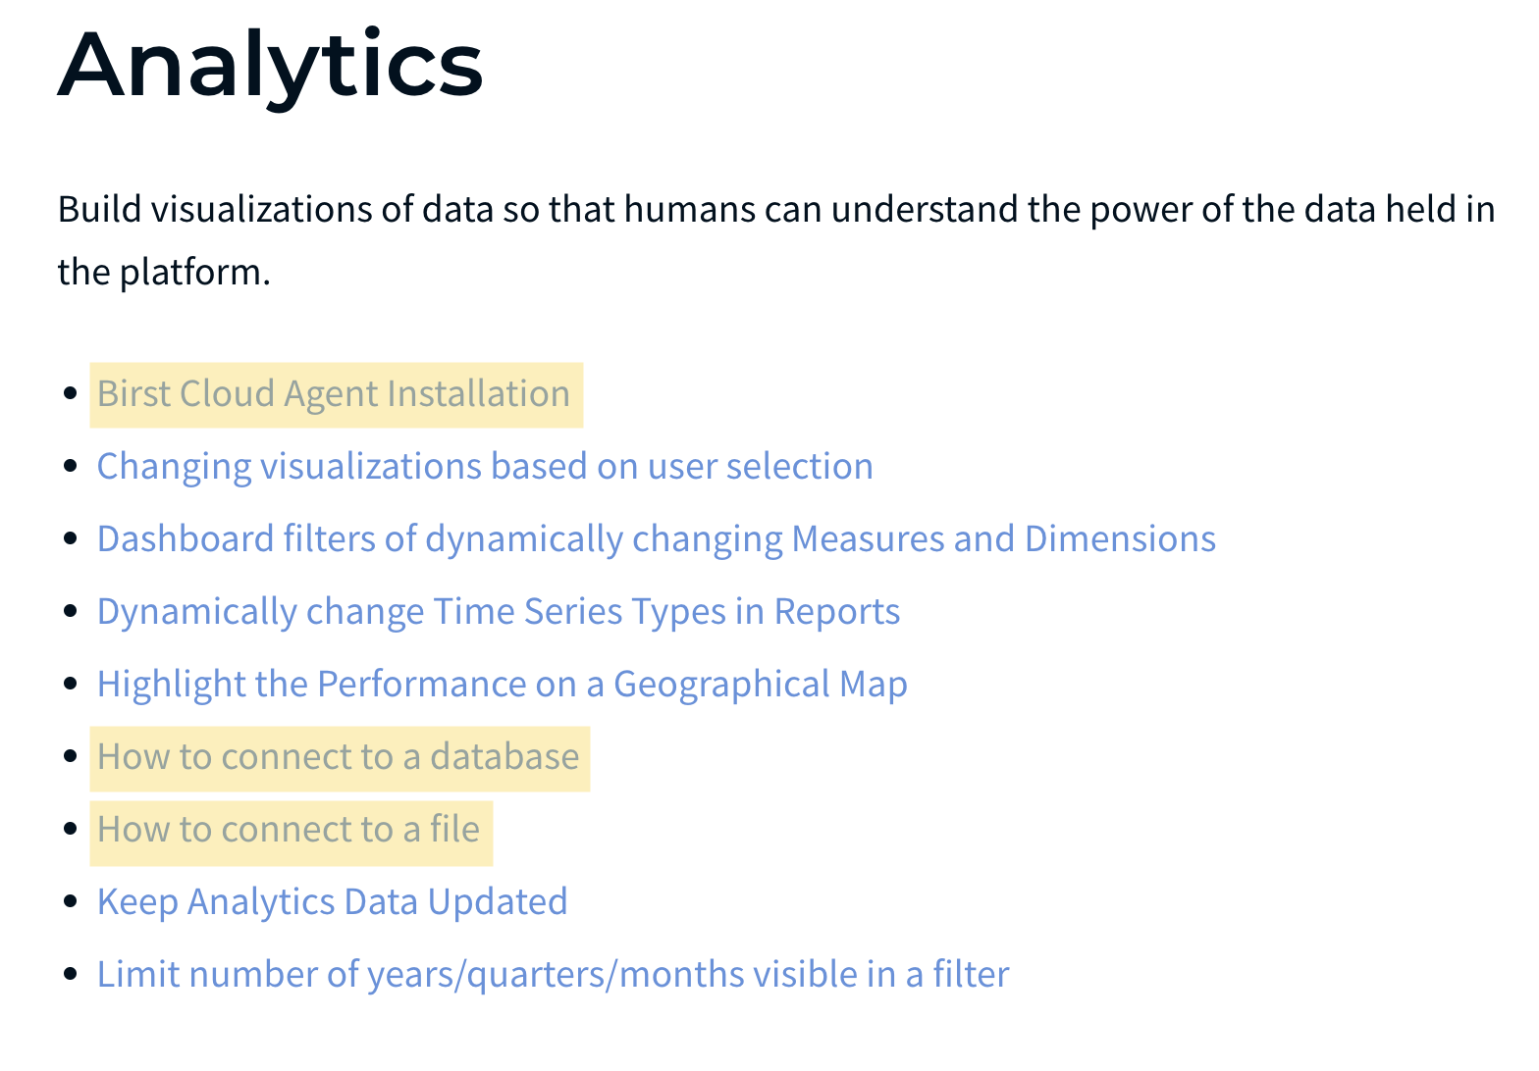
Tutorials
Task: Write tutorials to accompany YouTube videos on Developer Portal
Example: https://developer.infor.com/tutorials/analytics/birst-cloud-agent-installation/
4 tutorials live
8 tutorials under editorial review
Notes:
Briefly talk about writing process?

Slide 7

Meet InDevA
Infor Developer Assistant (InDevA)
A small-scale deep learning AI model that takes a written tutorial as an input and generates feedback.
Model type: T5-small (Transformer)
Tools used: Jupyter Notebook
Libraries used: Transformers, BeautifulSoup, Datasets
ThePhoto by PhotoAuthor is licensed under CCYYSA.
Notes:
InDevA -> Infor Developer Assistant
This is a small-scale AI model that takes a written tutorial and provides feedback
The model is a T5-small, which is a type of Transformer -> A transformer basically learns from the context and meaning of text and keeps track of those relationships
Some tools that were used: Jupyter Notebook for the coding environment and Python libraries for existing coding solutions

Slide 8
InDevA's Story

Slide 9
Project Steps Overview
Results & Conclusion
Model Training
Data Pre-processing & Cleaning
Data Collection
Research
Pre-processing

Slide 10


Pre-planning
Initial Goals:
Enforce uniformity across existing and new content
Improve the quality of all content with minimal supervision
The "Game" Plan
Research basic AI/ML concepts, natural language processing, and deep learning.
Build functions that will format and clean data, train the model, and generate feedback.
Fix bugs.
Repeat steps 2 and 3.
Obstacles:
Limited AI/ML knowledge and experience
Difficulty with defining the rules and guidelines for the model to follow
Time (9 weeks)
Unclear overall purpose
Notes:
When I first made this proposal, I wanted InDevA to be able to enforce uniformity across all content, existing and new ones, while improving the quality without having to constantly reviewing it -> wanting a solution that can automate the reviewing process
As part of my project proposal, I tried to think of as many problems that I would encounter (and I encountered way more than the ones listed)
Going into this project, I did not have any knowledge or experience with AI/ML (I was more interested in mobile and web development prior to this internship)
Because of the lack of knowledge, I was unsure how to define the rules for the model to follow, especially since sentences don't follow the same structure -> "Subject (noun) verb direct object"
9 weeks is not a whole lot of time to research and build a full-scale model, especially since there was a learning curve for how to train a model and brushing up on Python
It was hard to define the overall purpose for this model in the sense that am I building it just because I wanted to or was there additional business value
With these obstacles in mind, I came up with the plan and a loose schedule for each step where I allocated more time for research to make the coding process a bit smoother
Thus, I was able to allow more time for model training and fixing any issues

Slide 11





Research
AI/ML Introduction
AI Building Process
Supervised & unsupervised learning, machine learning, deep learning, artificial neural networks, and recurrent neural networks.
Data collection, data processing & cleaning, pre-training, fine-tuning, and evaluation metrics.
Natural Language
Processing
Transformers
Tokenization, stemming, lemmatize, sentiment analysis, topic modeling, and N-grams.
Attention systems, encoder-based & decoder-based models, such as BERT, RoBERTa, XLNet, and T5, and architecture.

Slide 12

Grammarly
A writing tool that uses AI to improve grammar and writing style
Algorithms are trained by linguists and deep learning engineers to combine machine learning, natural language processing, and human expertise
AI model reads each sentence and looks for ways to improve then it by correcting a verb tense, suggesting a stronger synonym, or recommending a clearer sentence structure
Grammarly Premium features include rewrite sentences for clarity, adjust tone, catch accidental plagiarism, and generate text based on prompts
ThePhoto by PhotoAuthor is licensed under CCYYSA.
ThePhoto by PhotoAuthor is licensed under CCYYSA.
ThePhoto by PhotoAuthor is licensed under CCYYSA.
ThePhoto by PhotoAuthor is licensed under CCYYSA.
Notes:
I also looked into existing tools that encapsulate InDevA's purpose, such as Grammarly. In way, InDevA is similar to Grammarly in that it is able to evaluate writing. However, I wanted it to be more specific to Infor.

Slide 13

Data Collection
Task: Gather the information to build the pre-training and training datasets.
Pre-training dataset: "Components" section from Developer Portal (Analytics)
Used to provide the model with additional information about InforOS applications
Training dataset: Analytic tutorials from the "Tutorials" section in the Developer Portal
Coded functions that web-scrape text from Developer Portal pages using BeautifulSoup library
Notes:
For InDevA to be able to generate feedback, I need to give it training datasets to learn from. Typically, training a model only requires a training dataset. However, I wanted my model to have more contextual information, so that the feedback is more specific to that application. Hence, I split the training into 2 parts: pre-training and training. The pre-training dataset only contains additional background information regarding a specific application. While the training dataset contained all the tutorials for that application.
Now, I had a bunch of text to use. I didn't just want to copy and paste the text and manually go through to pick out what I wanted. With scalability in mind, I thought about how can I simplify this task? So, I coded functions that would web-scrape/extract text from the web pages, given a URL link.

Slide 14

Data Pre-processing & Cleaning
Task: Format datasets as JSON strings.
Clean the datasets by coding functions to remove duplicate and unwanted text
Put the text in datasets and format them as JSON strings
ThePhoto by PhotoAuthor is licensed under CCYYSA.
Notes:
With all the text extracted, I wrote more functions that cleaned the text. When I was extracting the text, certain parts were duplicated and I had to remove the duplicates otherwise it might cause some issues when training the model. Also, some unwanted text was added to the dataset and I wanted to remove them, such as links to other pages in the portal, terms and conditions, etc.
The model reads text differently than we do, so it needed to be formatted in a certain way. Data frames (tables) are a common way to store data, however I didn't think it was the best way to store the text. So, I turned to JSON strings, which took a little bit more effort and time.

Slide 15
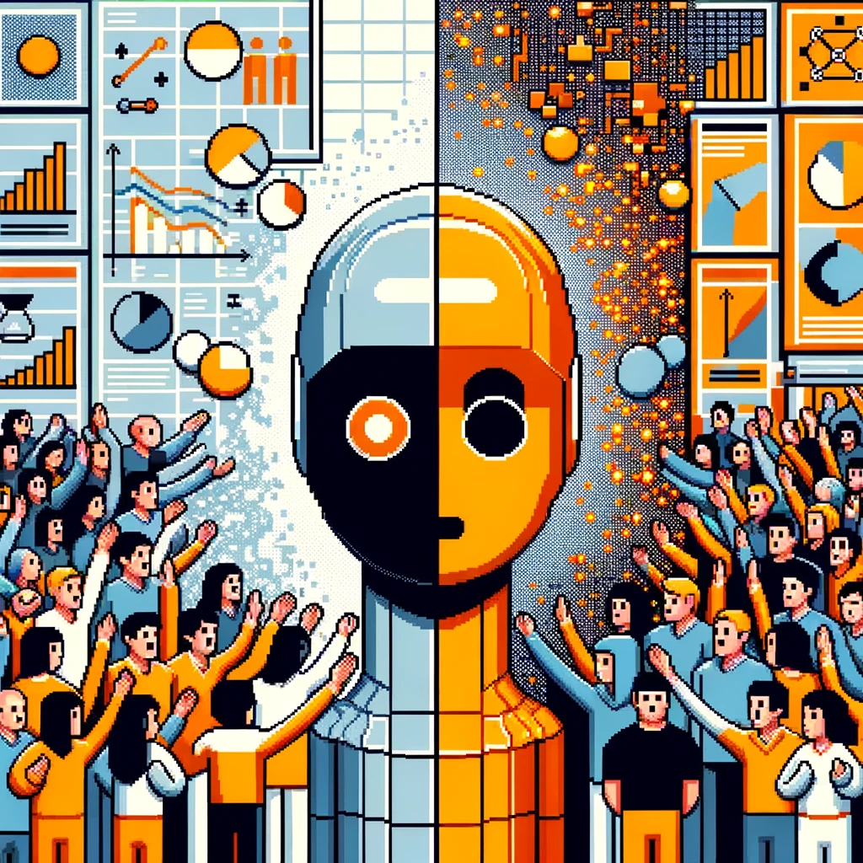
Model Training & Evaluation
Task: Train the model, evaluate the results, and fix bugs.
Pre-training phase: Use the pre-training dataset to train InDevA for more accurate feedback
Training phase: Use the training dataset to train InDevA to generate feedback
ThePhoto by PhotoAuthor is licensed under CCYYSA.
Notes:
When it came to start training the model, I ran into a big problem. I was working from my personal laptop, since I already have the required software and tools installed. However, my laptop did not have enough RAM to train the model. As a solution, I installed all the software onto my work laptop.
Additionally, with limited RAM, my model will not be full-scale and trained on everything from the Developer Portal. So I narrowed my dataset to focus on 1 category, Analytics.
When training the model, I ran into a whole other set of problems. I did not know what batch_size to use or how many epochs to use. So, I spent a little bit more time researching the specific training parameters and how to define them to fit my needs. However, I did not find the answer to all of the parameters and had to play around with the numbers until I got the best set of results. The training results are actually numbers that reflected my model's ability to go through the datasets, the amount of time it took, and how accurate it was. Even though, I had pretty good training results, my model's ability to provide feedback did not reflect it, which is another big issue. I had to go back and try out different parameters until my model's feedback improved.

Slide 16
Demo

Slide 17
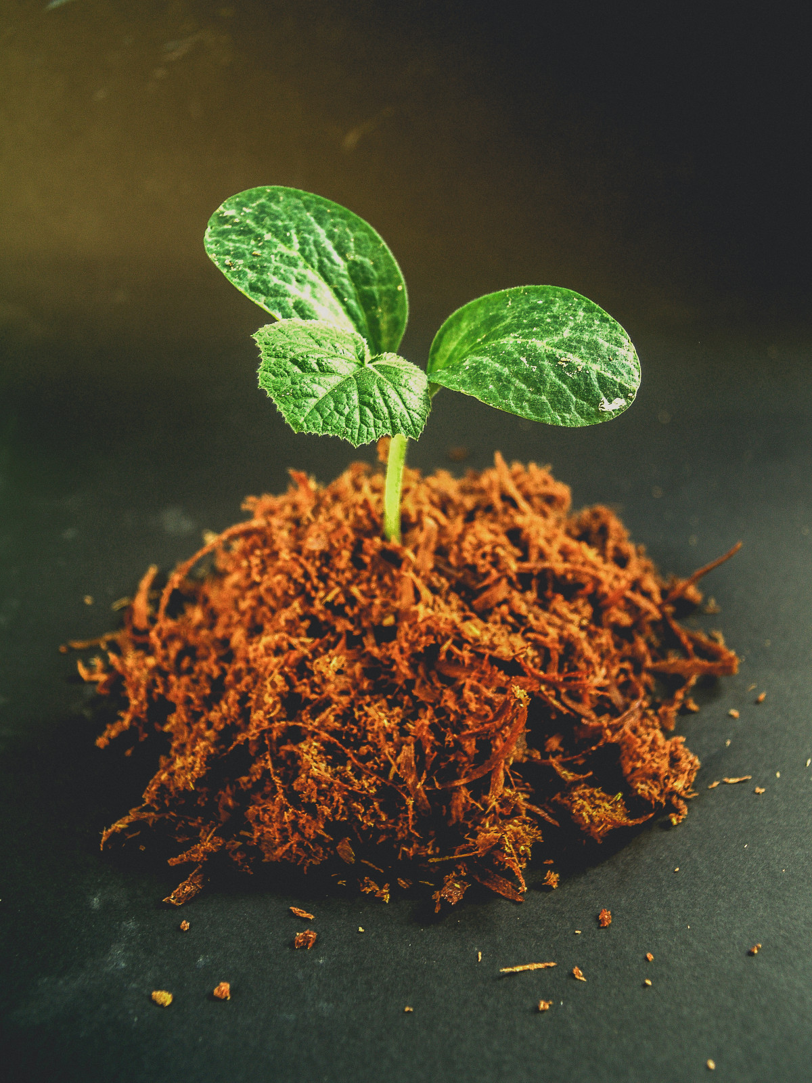
InDevA's Future
Features to be included:
Ability to notify the user (Developer Portal end) about outdated content
Ability to adapt to new situations with less supervision
Ability to use image and video processing to enhance pre-training and training datasets
Notes:
Throughout my research, I came across many topics and capabilities that I wanted to incorporate into my model, such as the ability to notify the user about outdated content, adapt new situations when encountered and without having to add more or update datasets, and use image and video processing to enhance the model's knowledge of InforOS applications.

Slide 18




Internship Outcomes
Contribution Motivated
Asked for help and feedback when struggling
Strove to realize potential with projects
Contributed creatively
Self-Actualize
Strove for constant improvement
Learned about strengths and how to apply them
Recognized need for continuous research and learning
Network
Worked with amazing people
Connected with other interns at Koch & Infor
Collaborated with Infor interns on a project
Contributions to Career
Explored AI/ML fields
Developed & strengthened technical writing and CS skills
Gained valuable working experience
Notes:
PBM: how many hours you've completed, apply a minimum of two principals to your internship and explain
Networking: talk about your networking experiences while interning
Conclusion: how this internship will contribute to your college and professional career moving forward
2 PBM principals that I applied to my internship were contribution motivated and self-actualize. Both my projects reflected contribution motivation because I wanted to be able to use my abilities and help others as much as I can. Meanwhile, my internship demonstrated the self-actualize principal as I was allowed to explore and work on something that I am passionate about (CS).
Networking -> During this internship, I got to meet and work with really amazing people. The Platform Product Strategists team is great and really welcoming. They helped contribute to my projects, but providing their input or suggesting resources. I was able to connect with other interns, who were in the same field, but were in different teams and companies across Koch. I also had the chance to work with the other remote Infor interns on a community service project, which was fun.
Contributions to career -> I got the opportunity to explore a field, that I never really considered as a career path. I definitely developed practical skills for working in a professional environment. Additionally, I was able to improve technical writing skills and programming skills.

Slide 19
Resources
Python libraries
BeautifulSoup: https://beautiful-soup-4.readthedocs.io/en/latest/
Transformers: https://huggingface.co/docs/transformers/en/index
PyArrow: https://pypi.org/project/pyarrow/
Datasets: https://huggingface.co/docs/datasets/en/index
NLTK: https://www.nltk.org/
Regular expressions (RE): https://docs.python.org/3/library/re.html
PyTorch: https://pytorch.org/docs/stable/library.html

Slide 20

Thank you!
Kevin Cole
Khalid Marbou & Platform Product Strategists Team
Max Fisher & Team404
Yasmin Barnes
Sara Provencal
Remote Interns Group
Bradley Stillwell
ThePhoto by PhotoAuthor is licensed under CCYYSA.
Notes:
InDevA -> Infor Developer Assistant
This is a small-scale AI model that takes a written tutorial and provides feedback
The model is a T5-small, which is a type of Transformer -> A transformer basically learns from the context and meaning of text and keeps track of those relationships
Some tools that were used: Jupyter Notebook for the coding environment and Python libraries for existing coding solutions

Slide 21
Thank you!

